Slide 1
Unit 3: ICS Organization & Features
Unit 3:
ICS Organization & Features

Slide 2
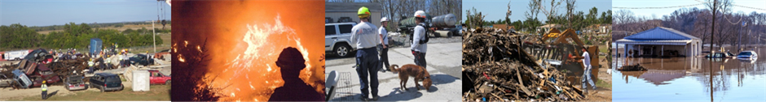
Unit Terminal Objective
Explain the NIMS Management Characteristics, the organizational structure of the Incident Command System, and the role of the Command and General Staff.

Slide 3
Unit Enabling Objectives
  Describe the organizational structure of the Incident Command System.
  Summarize the 14 NIMS Management Characteristics.
  Describe the roles and responsibilities of Command and General Staff within the ICS organization.
  Explain the attributes and purpose of Unified Command and Area Command

Slide 4

What is ICS?
The Incident Command System:
  Is a standardized, on-scene, all-hazards incident management concept.
  Allows its users to adopt an integrated organizational structure to match the complexities and demands of single or multiple incidents without being hindered by jurisdictional boundaries.

Slide 5
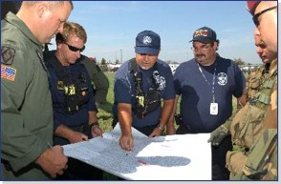
ICS Purposes
Using management best practices, ICS helps to ensure:
  The safety of responders and others.
  The achievement of tactical objectives.
  The efficient use of resources.

Slide 6
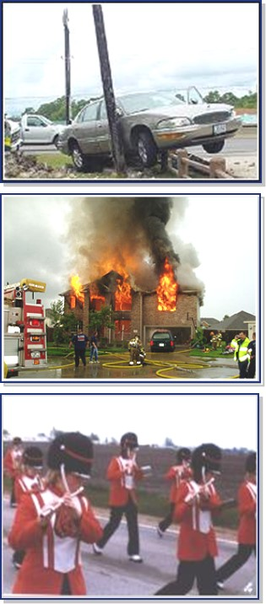
Examples of Incidents Managed Using ICS
Types of incidents that have been managed using ICS:
  Fire, both structural and wildland
  Natural disasters, such as tornadoes, floods, ice storms, or earthquakes
  Human and animal disease outbreaks
  Search and rescue missions
  Hazardous materials incidents
  Criminal acts and crime scene investigations
  Terrorist incidents, including the use of weapons of mass destruction
  NSSE, such as Presidential visits or the Super Bowl
  Other planned events, such as parades or demonstrations

Slide 7
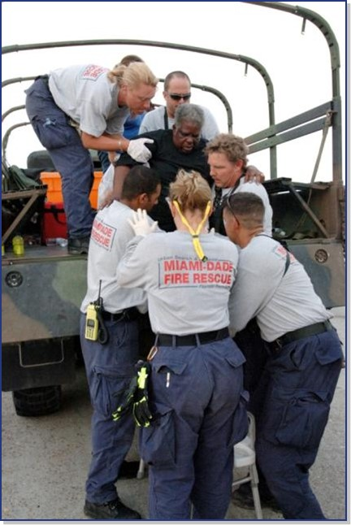
ICS Benefits
  Meets the needs of incidents of any kind, size, or complexity.
  Allows personnel from a variety of agencies to meld rapidly into a common management structure.
  Provides logistical and administrative support to operational staff.
  Is cost effective by avoiding duplication of efforts.

Slide 8
ICS Organization
Differs from the day-to-day, administrative organizational structures and positions.
  Unique ICS position titles and organizational structures are designed to avoid confusion during response.
  Rank may change during deployment. A "chief" may not hold that title when deployed under an ICS structure.

Slide 9
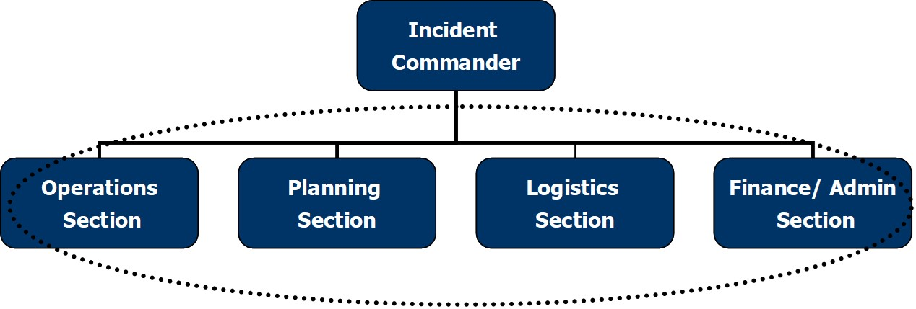
ICS Structure

Slide 10
NIMS Management Characteristics
14 foundational characteristics of incident Command and Coordination under NIMS:
 | Common Terminology Management by Objectives Manageable Span of Control Comprehensive Resource Management Establishment and Transfer of Command Chain of Command and Unity of Command Dispatch/Deployment | Modular Organization Incident Action Planning Incident Facilities and Locations Integrated Communications Unified Command Accountability Information and Intelligence Management

Slide 11
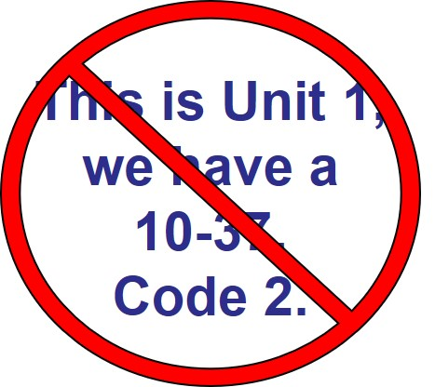
Common Terminology
ICS requires the use of common terminology to define:
  Organizational functions.
  Incident facilities.
  Resource descriptions.
  Position titles.
Use plain language and clear text, not codes.

Slide 12
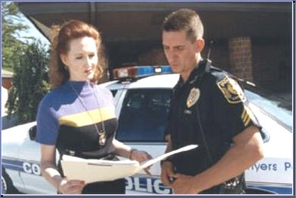
Management by Objectives
  ICS is managed by objectives.
  Objectives are communicated throughout the entire ICS organization.
  Available resources must support incident objectives.

Slide 13
Incident Action Planning
IC creates an Incident Action Plan (IAP) that:
  Specifies the incident objectives.
  States the activities to be completed.
  Covers a specified timeframe, called an operational period.
  May be oral or written—except for hazardous materials incidents, which require a written IAP.
  Takes into account legal and policy considerations and direction.

Slide 14

Modular Organization
  Develops in a top-down, modular fashion.
  Is based on the size and complexity of the incident.
  Is based on the hazard environment created by the incident.

Slide 15
Modular Organization (Cont.)
  Incident objectives determine the organizational size.
  Only functions/positions that are necessary will be filled.
  Each element must have a person in charge.

Slide 16

National Incident Management System
  Guideline is 1:5 but actual ratio varies
  Incident personnel use their best judgment to determine effective span of control

Slide 17
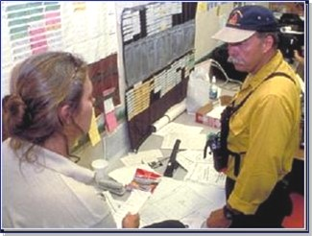
Comprehensive Resource Management
Resources include personnel, equipment, teams, supplies and facilities.
Resource management includes processes for:
  Maintaining accurate, updated resource inventories.
  Resource activities to prepare for and respond to an incident.
  Reimbursement for resources used.

Slide 18
Integrated Communications
Incident communications are facilitated through:
  Common communications plan.
  Interoperable communications processes and systems.
  Planning, to achieve integrated voice and data communications.
Before an incident, it is critical to develop an integrated voice and data communications system (equipment, systems, and protocols).

Slide 19
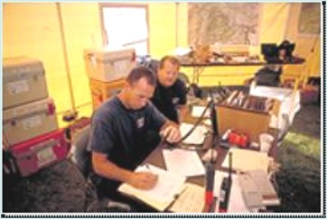
Establishment and Transfer of Command
The jurisdiction or organization with primary responsibility for the incident designates the individual at the scene responsible for establishing command and protocol for transferring command.

Slide 20
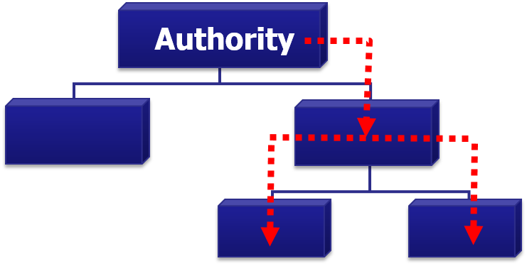
Chain of Command & Unity of Command
  Chain of command is an orderly line of authority within the ranks of the incident management organization.
  Unity of command means that every individual has a designated supervisor to whom he or she reports at the scene of the incident.

Slide 21
Unified Command
  Established when no one jurisdiction, agency, or organization has primary authority and/or the resources to manage an incident on its own.
  Manages the incident by jointly approved objectives.

Slide 22
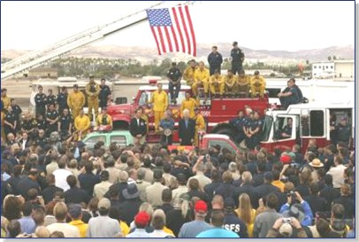
Dispatch/Deployment & Accountability
At any incident, resources should:
  Deploy only when appropriate authorities request.
  Dispatch through established resource mgmt. systems.
  NOT spontaneous deploy if not requested by authorities.
  Be accountable, check in and out, use tracking systems.

Slide 23
Incident Facilities and Locations
  Depending on the incident size and complexity, Command establishes support facilities for a variety of purposes and directs their identification and location based on the incident.
  Typical facilities include the Incident Command Post (ICP), incident base, staging areas, camps, mass casualty triage areas, points-of-distribution, and emergency shelters.

Slide 24
Information and Intelligence Management
  The incident management organization establishes a process for gathering, analyzing, assessing, sharing, and managing incident-related information and intelligence.
  Process includes identifying EEI to ensure personnel gather the most accurate and appropriate data, translate it into useful information, and communicate it with appropriate personnel.

Slide 25
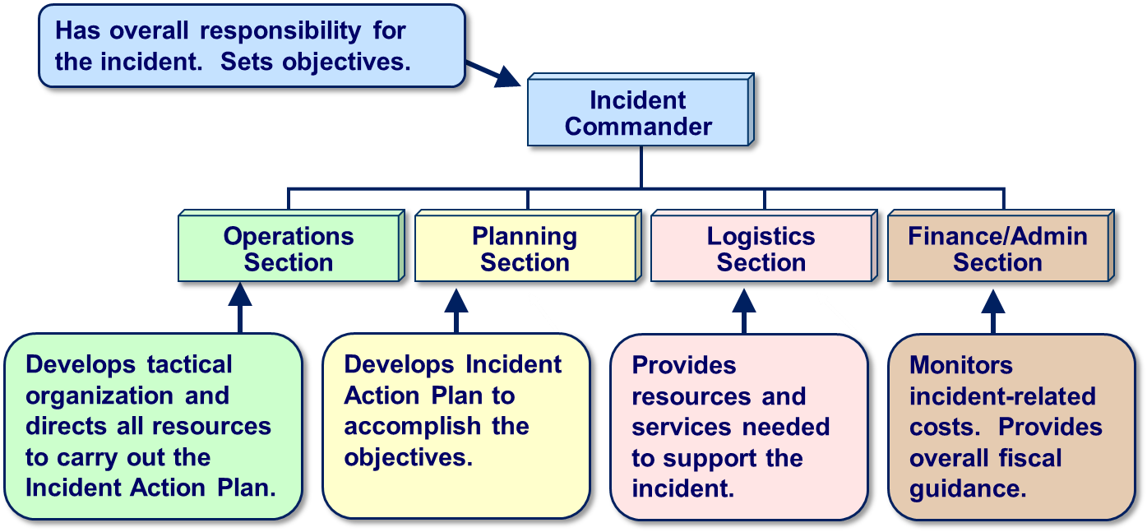
ICS - Who Does What?

Slide 26

Establishing Incident Command
Upon arriving at an incident, the higher ranking person will either assume command, maintain command as is, or transfer command to a third party.
The MOST QUALIFIED person at the scene is designated as the Incident Commander.

Slide 27
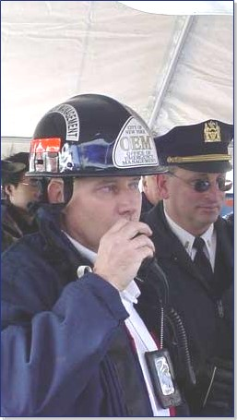
Incident Commander's Role
  Overall leadership for incident response
  Receives policy direction from the Senior Official
  Establishes incident objectives
  Directs development of Incident Action Plan
  Ensures incident safety
  Delegates authority to others
  Ensures coordination with EOC and JIC
  Provides information to internal and external stakeholders
  Establishes and maintains liaison with other agencies participating in the incident

Slide 28

Senior Official's Role in Incident Command
  Delegate authority for on-scene operations to IC/ UC
  Provide policy guidance on priorities and objectives
  Activate specific legal authorities
  Oversee resource coordination and support to the Incident Command through the EOC

Slide 29
Delegation of Authority
Delegation of authority may be in writing (established in advance) or verbal, and include:
  Legal authorities and restrictions.
  Financial authorities and restrictions.
  Reporting requirements.
  Demographic issues.
  Political implications.
  Agency or jurisdictional priorities.
  Plan for public information management.
  Process for communications.
  Plan for ongoing incident evaluation.

Slide 30
Summary: Incident Management Roles
Incident Commander Manage the incident at the scene Keep the EOC/ MAC Group informed on all important matters pertaining to the incident Joint Information System Enable communication between incident personnel Provide Critical Information to the Public | EOC Director and Staff Support the Incident Commander and the MAC Group: Provide Resources Plan for Resource Requirements Facilitate Situational Awareness Senior Officials/ MAC Group Provide the Incident Commander and the EOC staff: Authority Mission & Strategic direction Policy

Slide 31
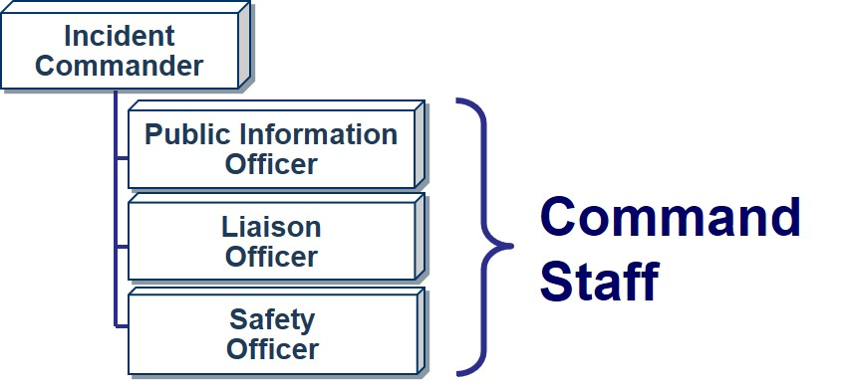
Command Staff
The incident may designate Command Staff members who will:
  Provide information, liaison, and safety services for the Incident Command.
  Report directly to the Incident Commander.

Slide 32
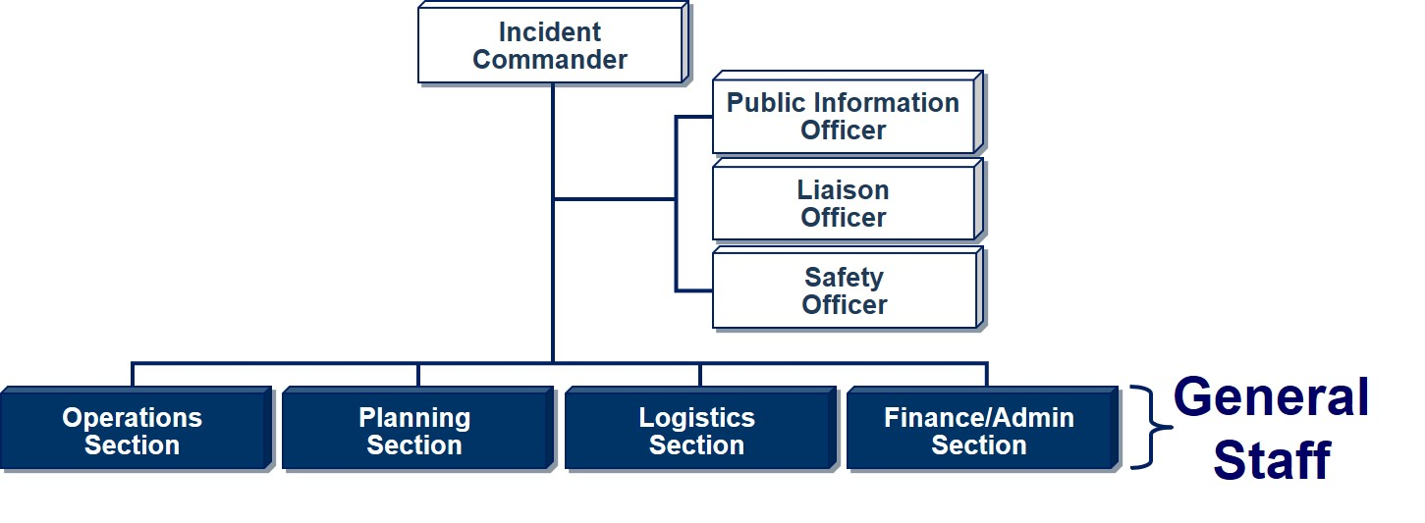
General Staff
As the incident expands in complexity, the Incident Commander may add General Staff Sections to maintain span of control.

Slide 33
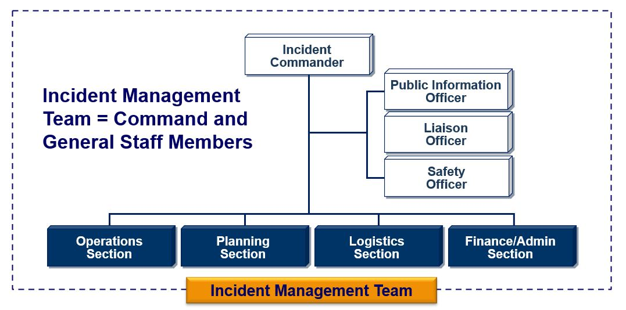
Incident Management Team (IMT)

Slide 34
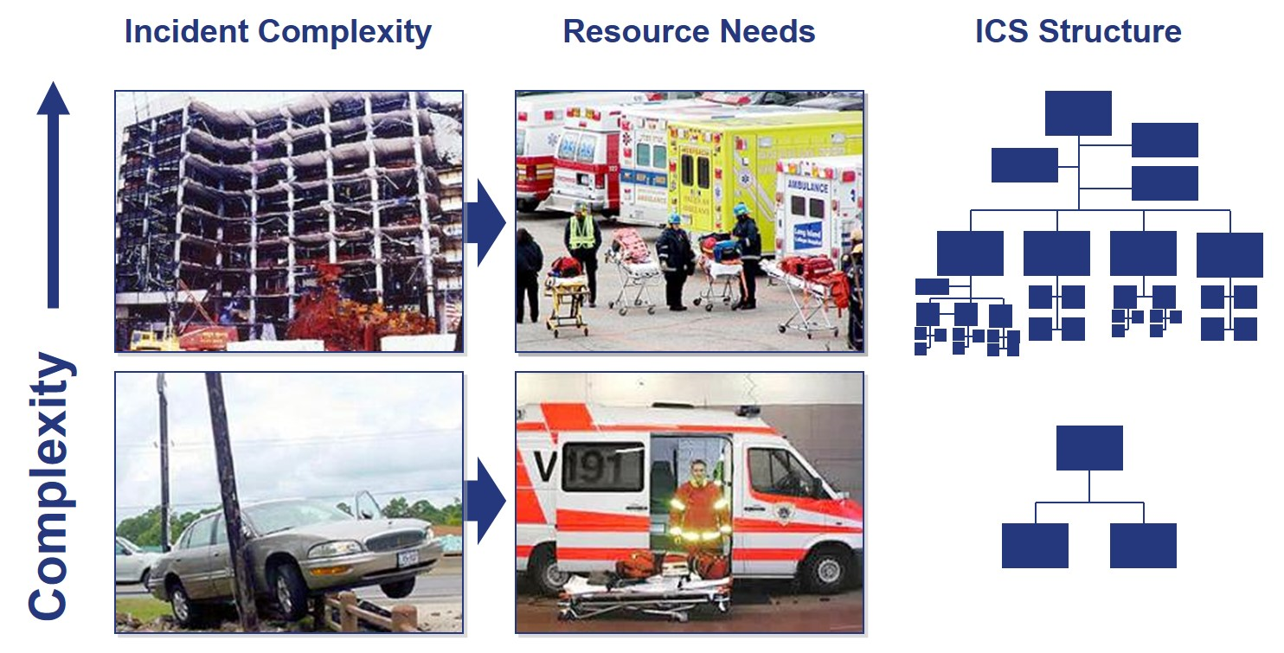
Incident Complexity and Resource Needs

Slide 35
Complexity Analysis Factors
In your agency or jurisdiction, what factors may affect the complexity of an incident?

Slide 36
Incident Timeframes
How long will a complex incident last?
How long do we need to be self-sufficient?
How will you know that the incident is over?

Slide 37
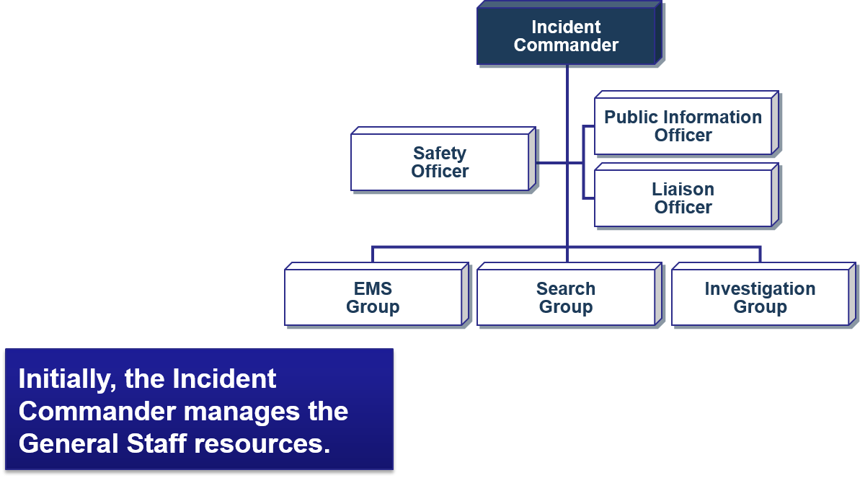
Example: Expanding Incident (Part 1)
Scenario: On a chilly autumn day, a parent calls 911 to report a missing 7-year-old child in a wooded area adjacent to a coastal area.

Slide 38
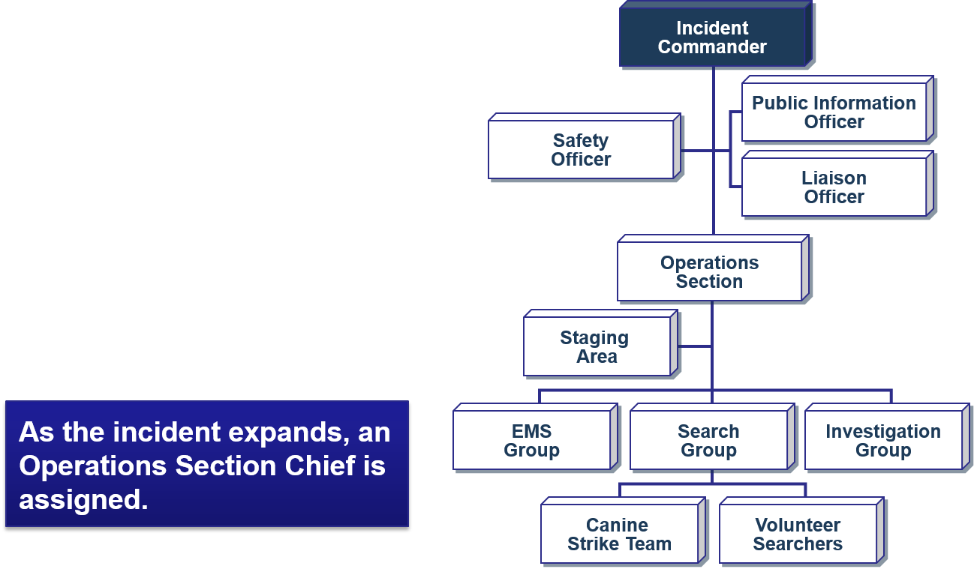
Example: Expanding Incident (Part 2)
Scenario: As additional resource personnel arrive, the Incident Commander assigns an Operations Section Chief to maintain span of control.

Slide 39
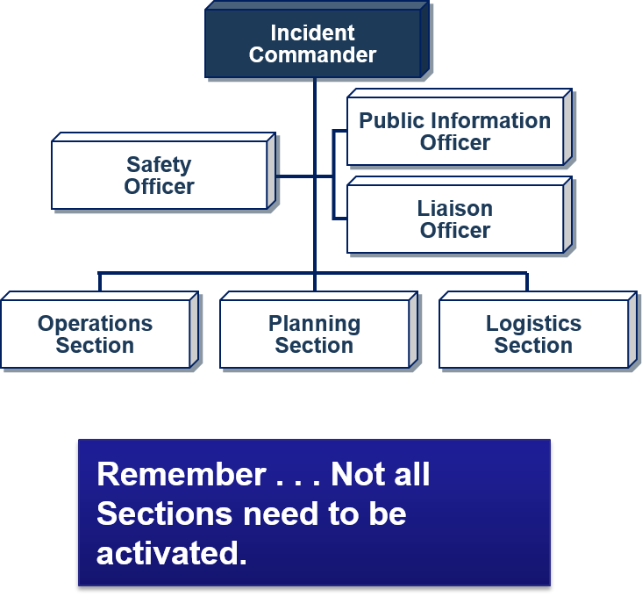
Example: Expanding Incident (Part 3)
Scenario: With hundreds of responders and volunteers arriving, there is a need for on-scene support of the planning and logistics functions.
The Incident Commander adds a Planning Section Chief and Logistics Section Chief.

Slide 40
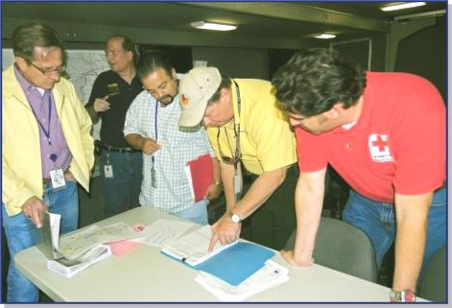
Unified Command
Unified Command does not affect individual agency authority, responsibility, or accountability.
In Unified Command, no agency’s legal authorities will be compromised or neglected.

Slide 41
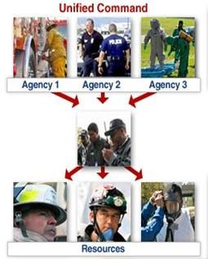
Unified Command (Cont.)
UC establishes:
  Common set of objectives.
  Single IAP.
  Single command structure.
  Single, unified staff under the UC.
Maintains unity of command. Each employee only reports to one supervisor.
There is no one "commander."

Slide 42
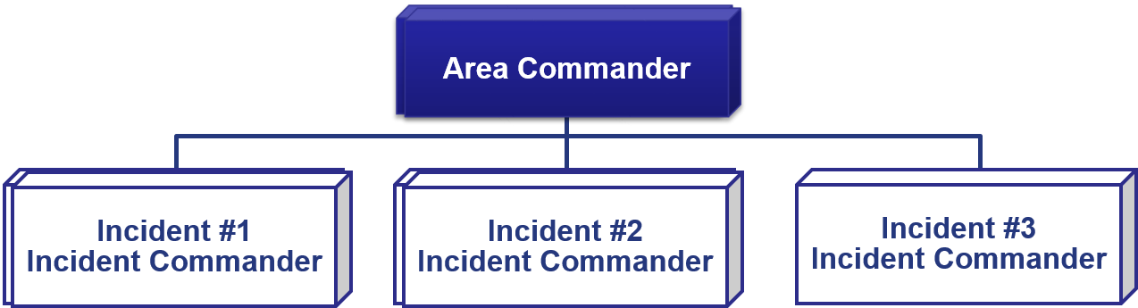
Definition of Area Command
Area Command is used to oversee the management of:
  Multiple incidents that are each being handled by an Incident Command System organization; or
  A very large incident that has multiple incident management teams assigned to it.

Slide 43
Objectives Review
  What is the organizational structure of the Incident Command System?
  Summarize the 14 NIMS Management Characteristics.
  What are the roles and responsibilities of the Command Staff positions and the General Staff Sections within the ICS organization?
  What are the attributes and purpose of Unified Command and Area Command?

